Slide 1
Quantitative model on MPF Assets allocation
Analyst: Ko Wai Mei
Notes:
大家好,今日想同大家分享下有關利用Quantitative既Model,去幫助你進行MPF account入面既資產分配

Slide 2
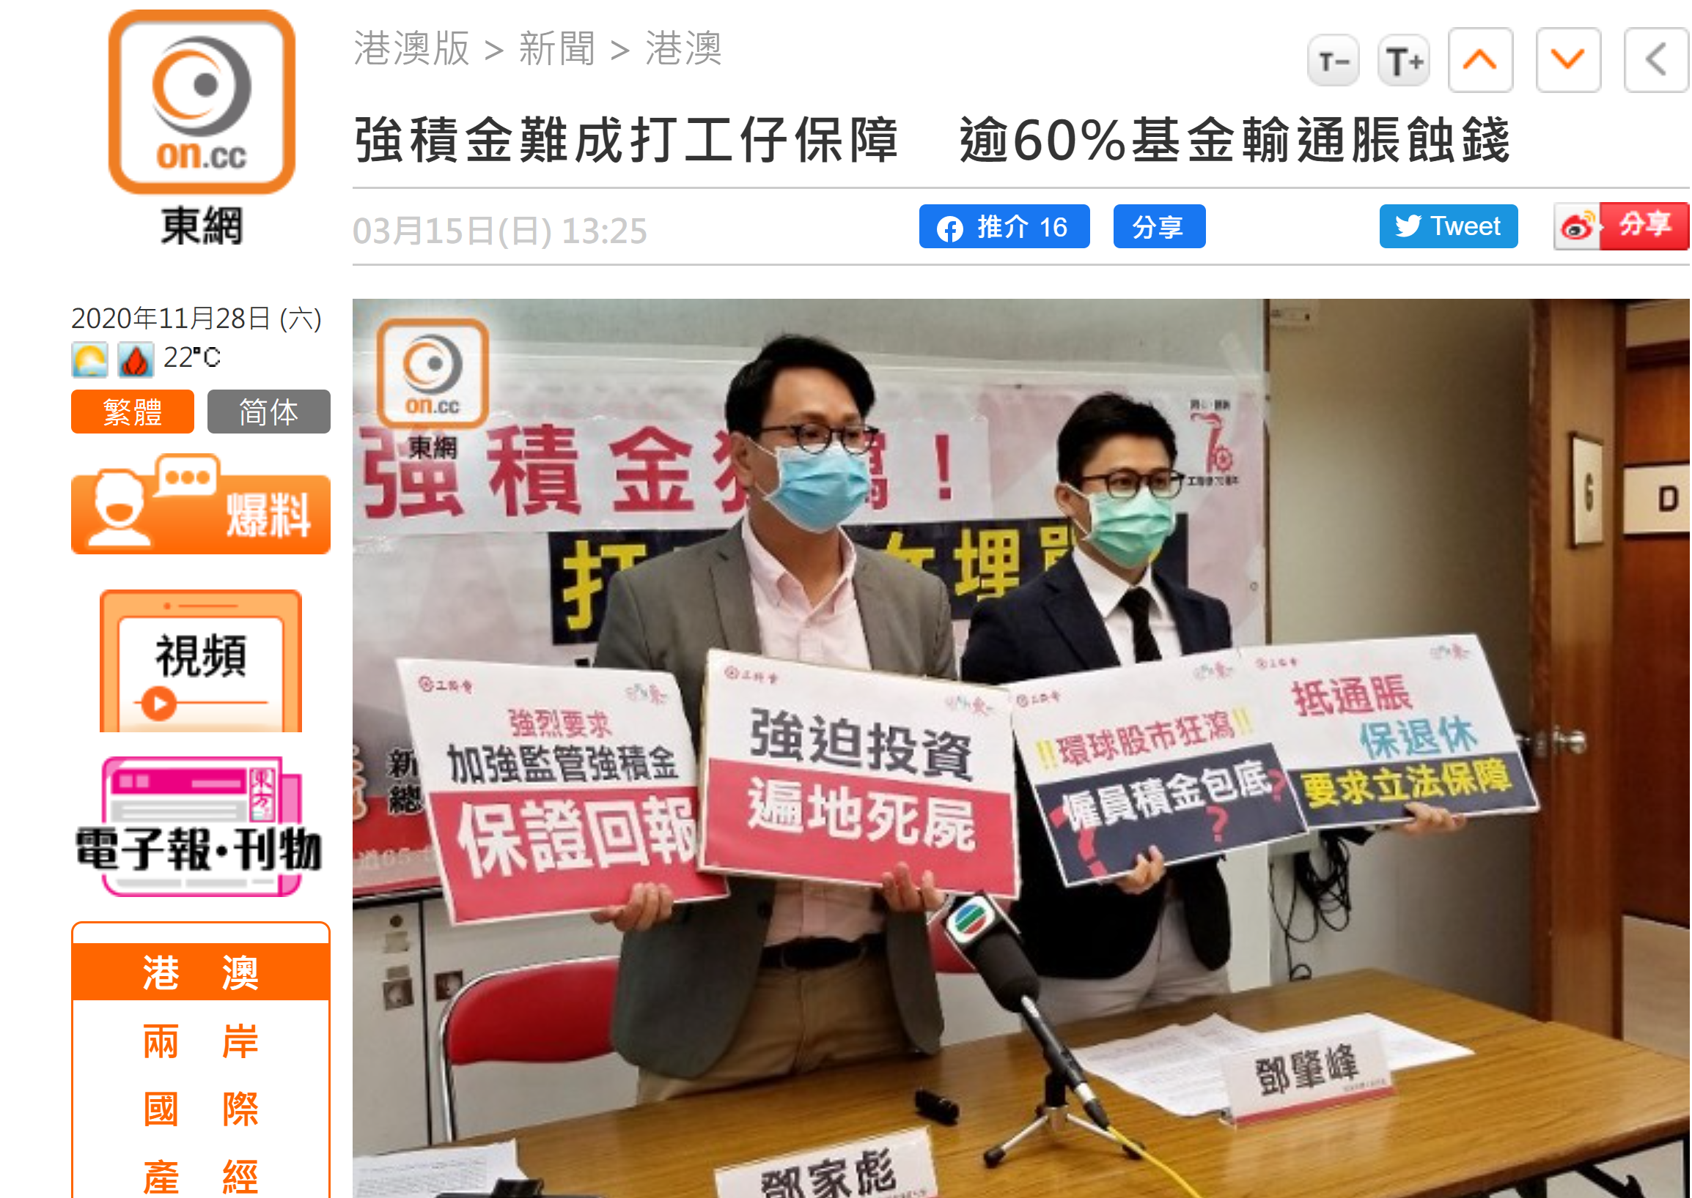

Are you confident in your MPF asset allocation?
Notes:
咁係呢度想問下大家先啦,大家對於自己分配MPF Account入面既資產分配有冇信心呢?
知唔知究竟邊隻fund應該擺幾多?
最近有唔少新聞都講緊, 好多人既MPF account都蝕緊錢, 但MPF又係強制供款架喎, 到底邊先可以唔令自己個MPF account越買越少錢?

Slide 3


What if a good asset allocation can save your MPF account from loss or it even gains more than HSI?
Notes:
如果我同你講,一個好既MPF資產配置可以令你個account唔使負回報不突止,仲可以跑贏大市,而個過程係唔需要你有好深既財務能力?

Slide 4


oo
1. Backtesting Information
Background information of investor
Choices of funds
Preview of the backtesting result
2. System explanation
Workflow of the system
3. Model exploration
Introduction of the LightGBM model
Model Performance and factor independence
4. Portfolio Performance
Portfolio Statistic
Reason for portfolio
Crisis management

Slide 5
Background Information of backtesting

Slide 6

Profile of investor
Will contribute fixed amount per month to his/her MPF account
In the backtesting example, assuming HKD2000/month
Willing to rebalance his/her portfolio each month
Aggressively get capital growth with a relatively safe asset allocation

Slide 7
Choices of funds (Using AIA MPF funds as sample)
Total 24 funds
65歲後基金
大中華股票基金
中港動態資產配置基金
中港基金
日本股票基金
北美股票基金
全球基金
均衡組合
亞洲股票基金
亞洲債券基金
亞歐基金
美洲基金
香港股票基金
核心累積基金
基金經理精選退休基金
強積金保守基金
富達增長基金
富達穩定資本基金
富達穩定增長基金
綠色退休基金
增長組合
歐洲股票基金
環球債券基金
穩定資本組合

Slide 8
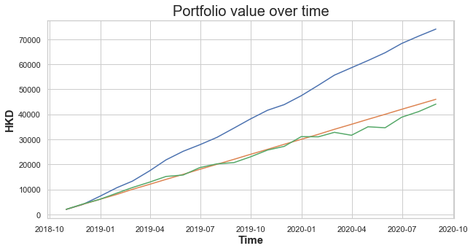
Backtesting result during 31/10/2018 - 30/9/2020
Our portfolio
Investing in HSI
Without Investing
Our portfolio
VS
Other assets allocation

Slide 9
System Explanation

Slide 10
Funds allocation System
Websites of the MPF schemes/
MPFA
Data
From 2000-12-01
To
2020-10-22
Get the monthly return of the data
Modeling data
From 2000-12-01
to
2018-09-30
Test data
From 2018-10-31
to
2020-9-30

Slide 11
Funds allocation System
Modeling data
From 2000-12-01
to
2018-09-30
Use slicing window and generate weight for each fund in each period
Each weighting cannot be smaller than 2%
Analyse the monthly return
by applying the weightings for a month
Label the data:
With 1:
1. Portfolio monthly return >= HIS monthly return+3%
2. Portfolio monthly standard derivation < HIS monthly standard derivation
With 0:
1. Portfolio monthly return < HIS monthly return+3%
2. Portfolio monthly standard derivation > HIS monthly standard derivation

Slide 12
Labelling Illustration
Portfolio 1
Date | Fund 1 |  | Fund 24 | Portfolio Value | Portfolio Return | Portfolio Volatility
2001-01-31 | 1.1403 | …… | 103.3820 | 208.2536
2001-02-28 | 1.1605 | …… | 105.3451 | 219.3535 | 5.33% | 4.57%
…
Weighting 1
Weighting 24
Weightings are randomized for simulating different market portfolios
Calculated by:
2001-01-31 weighting
x
2001-02-28 Assets prices

Slide 13
Labelling Illustration
Portfolio 1
Date | Fund 1 |  | Fund 24 | Portfolio Value | Portfolio Return | Portfolio Volatility
2001-01-31 | 1.1403 | …… | 103.3820 | 208.2536
2001-02-28 | 1.1605 | …… | 105.3451 | 219.3535 | 5.33% | 4.57%
…
Weighting 1
Weighting 24
More than 3%
Only these two conditions are met
Label the weightings for 2001-01-31 with 1
Otherwise, label with 0
1%
6%
HSI
Return
for Feb
HSI
Volatility
for Feb

Slide 14
Funds allocation System
Inputs:
Weightings for each fund
Label associated with weightings
(Target Variable)
LightGBM Model
Learn what factors make the weightings being good
-> those labelled with 1
Output:
Trained Model

Slide 15
Funds allocation System
Inputs:
Weightings for each fund for each month
Trained Model
Outputs:
Good weightings
Apply the optimal weightings to construct your portfolio
Selected a best weighting for that period depending on your choice
Highest return
Minimum volatility
- Highest Sharpe ratio

Slide 16
Model Exploration

Slide 17
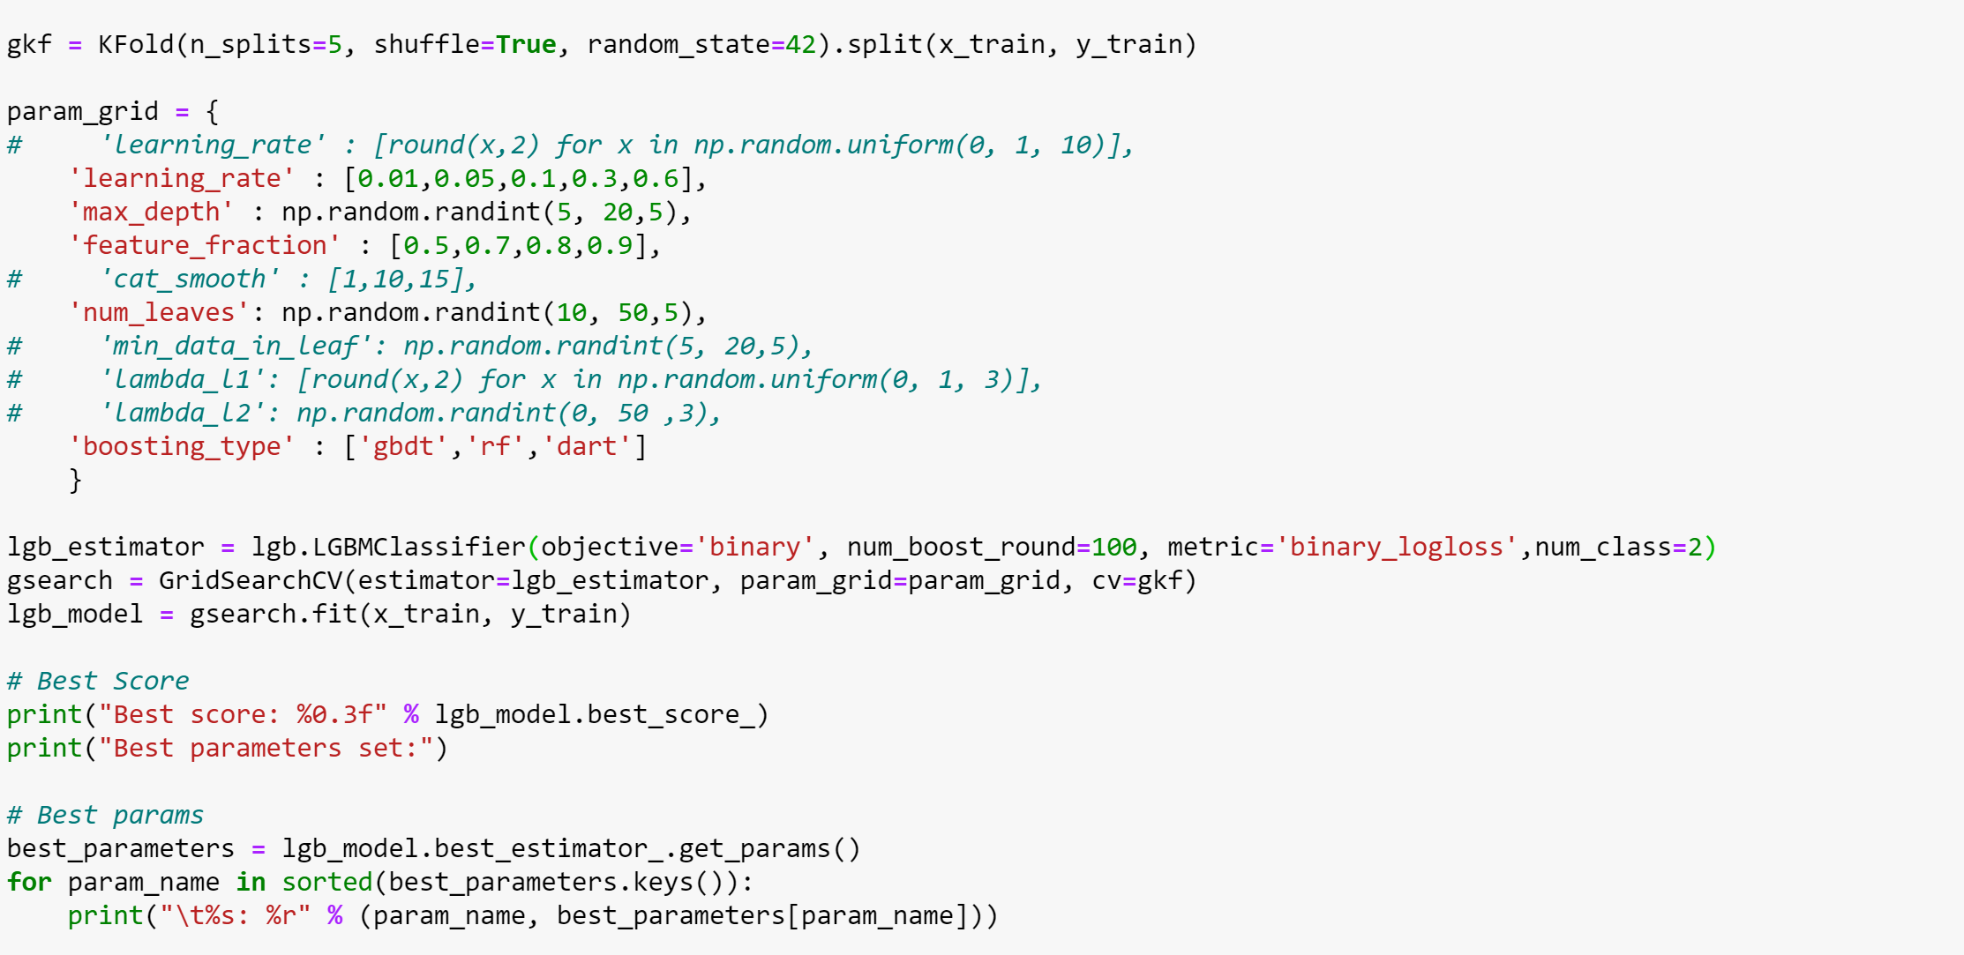
Introduction of the LightGBM model
The most common model used by the Kaggle champions
Fast training speed and low memory usage
High-performance gradient boosting framework – for financial data

Slide 18
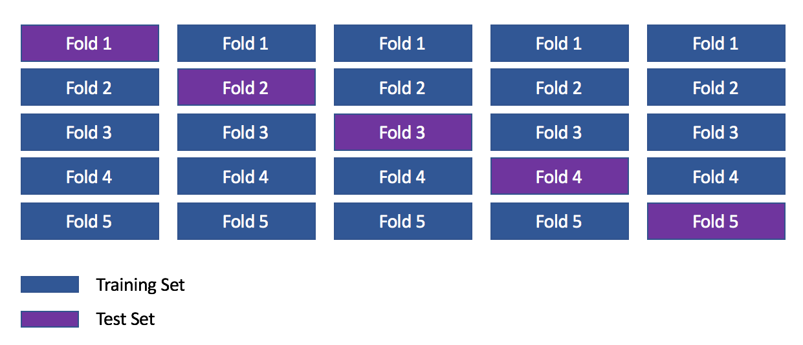
Techniques for optimising the model
- Cross validation

Slide 19
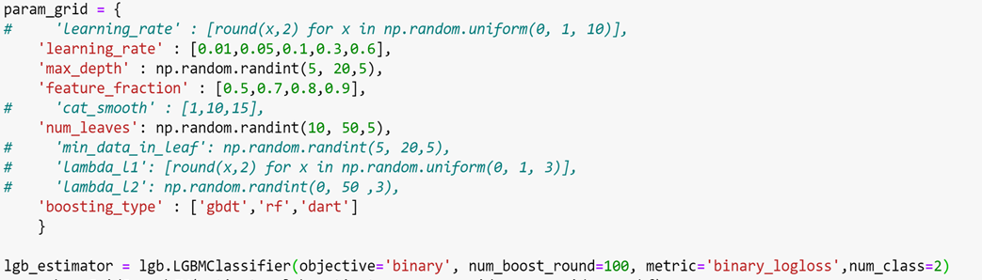
Techniques for optimising the model
Grid Search
Tuning the hyper parameters of the model for better prediction
Sample of parameters adopted by the model

Slide 20
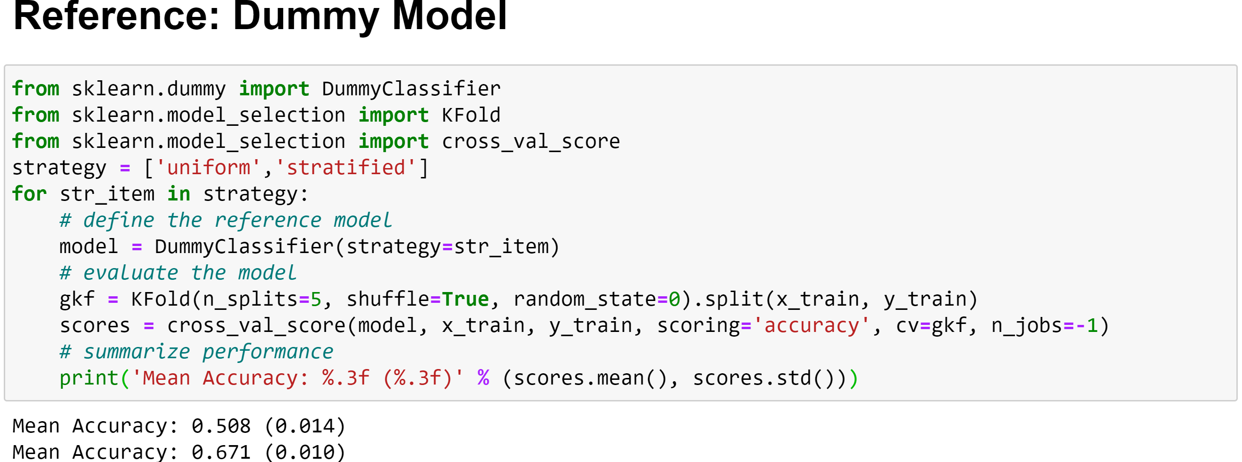
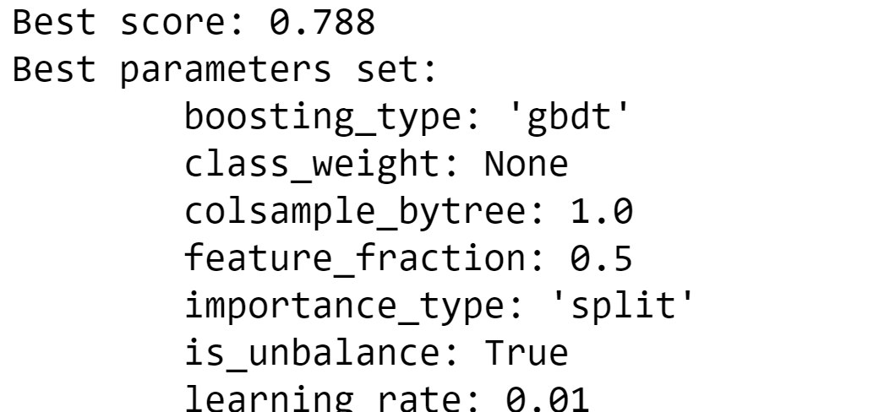
Performance of the model
Result of LightGBM model

Slide 21
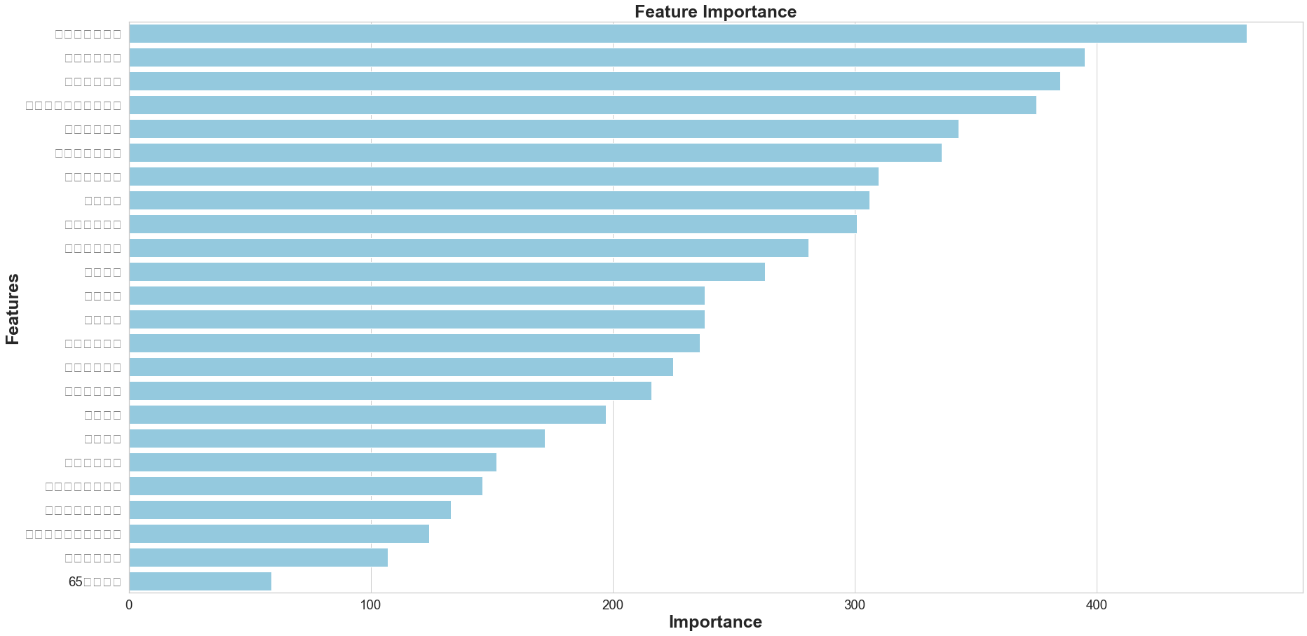
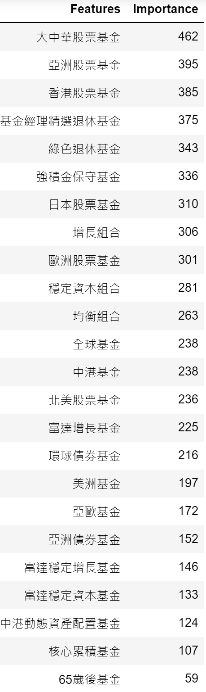
Features Importance

Slide 22
Portfolio Performance

Slide 23
Portfolio Statistics
Backtesting result during
31/10/2018 - 30/9/2020
System Selected Portfolio
HSI
Difference
Total period retuen (%) | 9.69 | -15.58 | 25.27
Total period standard deviation (%) | 4.44 | 0.06 | 4.38
Annulised return (%) | 4.74 | -8.12 | 12.86
Annulised standard deviation (%) | 1.13 | 0.79 | 0.34

Slide 24
Why do we need a portfolio?

Slide 25
Reasons for constructing a portfolio
Seek advantage of different investment instruments
Risk Diversification and Reduction
Set your mind more peaceful

Slide 26
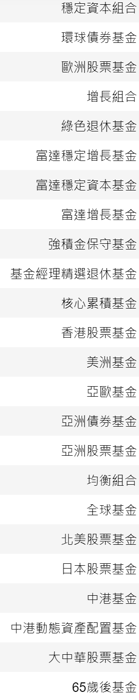
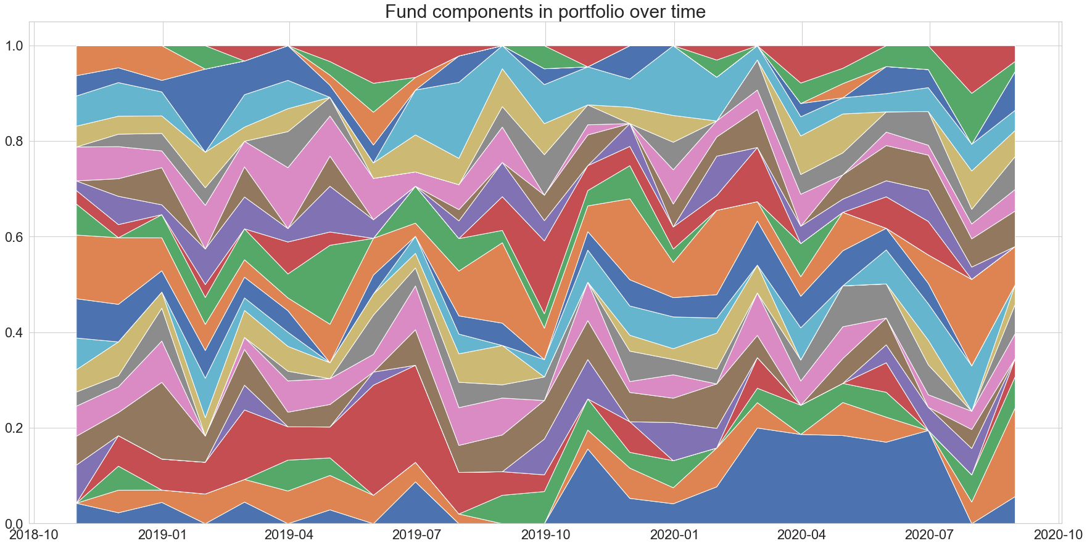


Components of fund over time

Slide 27
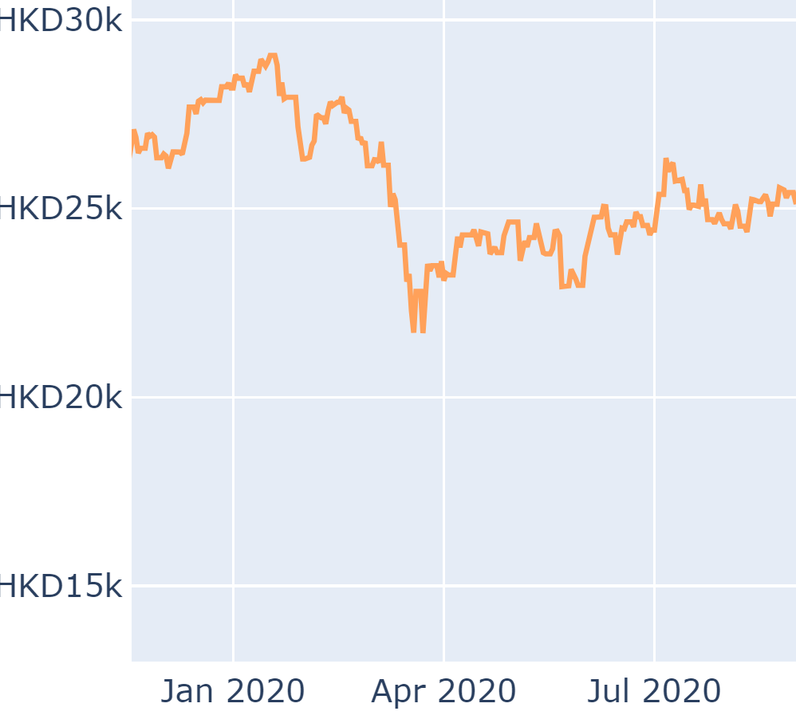
HSI in the same period

Slide 28
Appendix: Details of funds with high importance in model

Slide 29
What can be next?
Notes:
繼續優化個model令佢有更好的表現
學習更新既數據令佢更加update
去我地個website度試用下啦

Slide 30
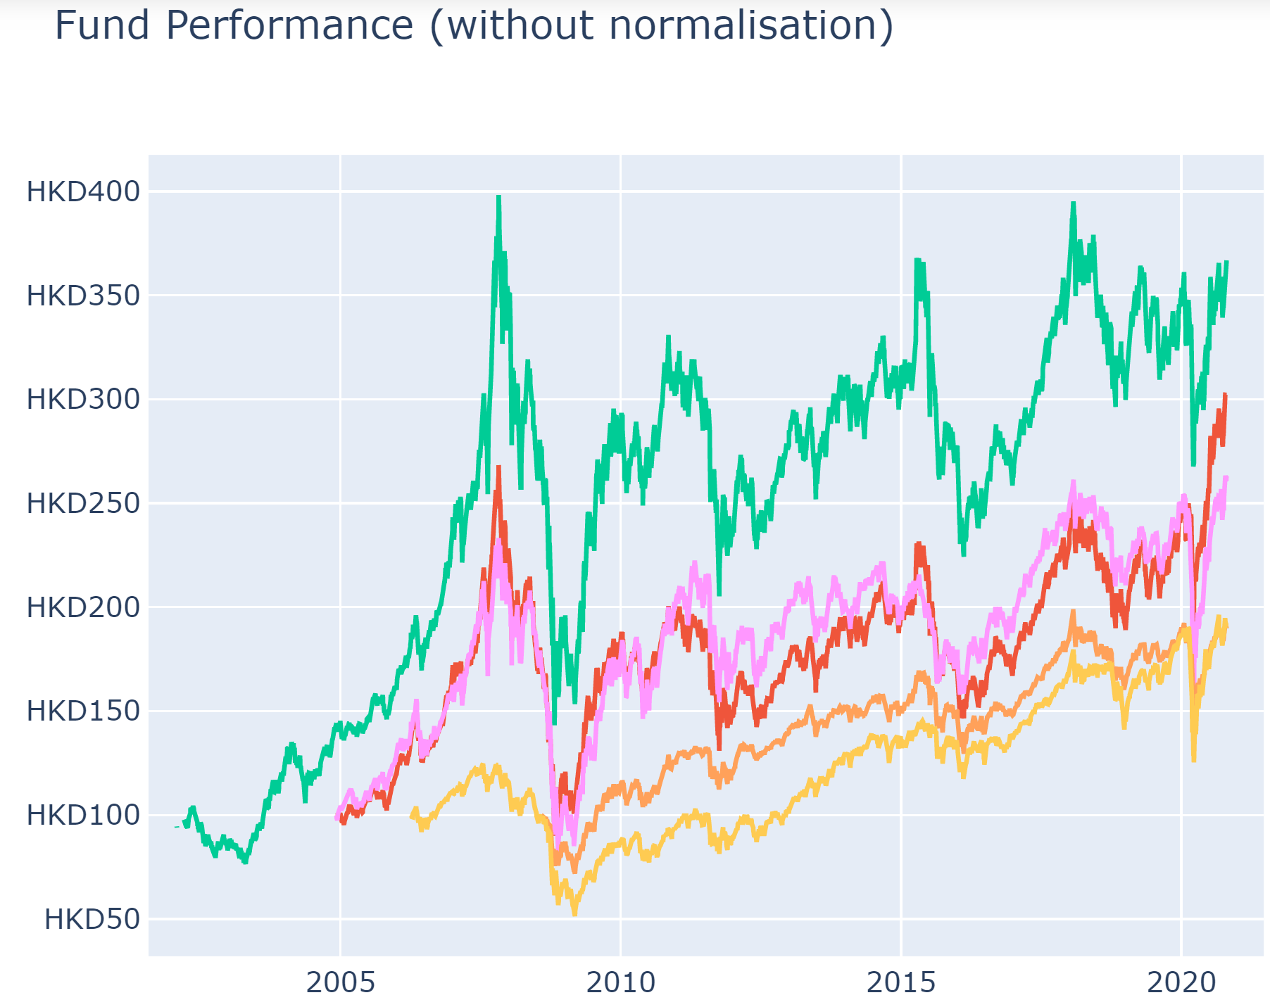
Combined funds graph

Slide 31
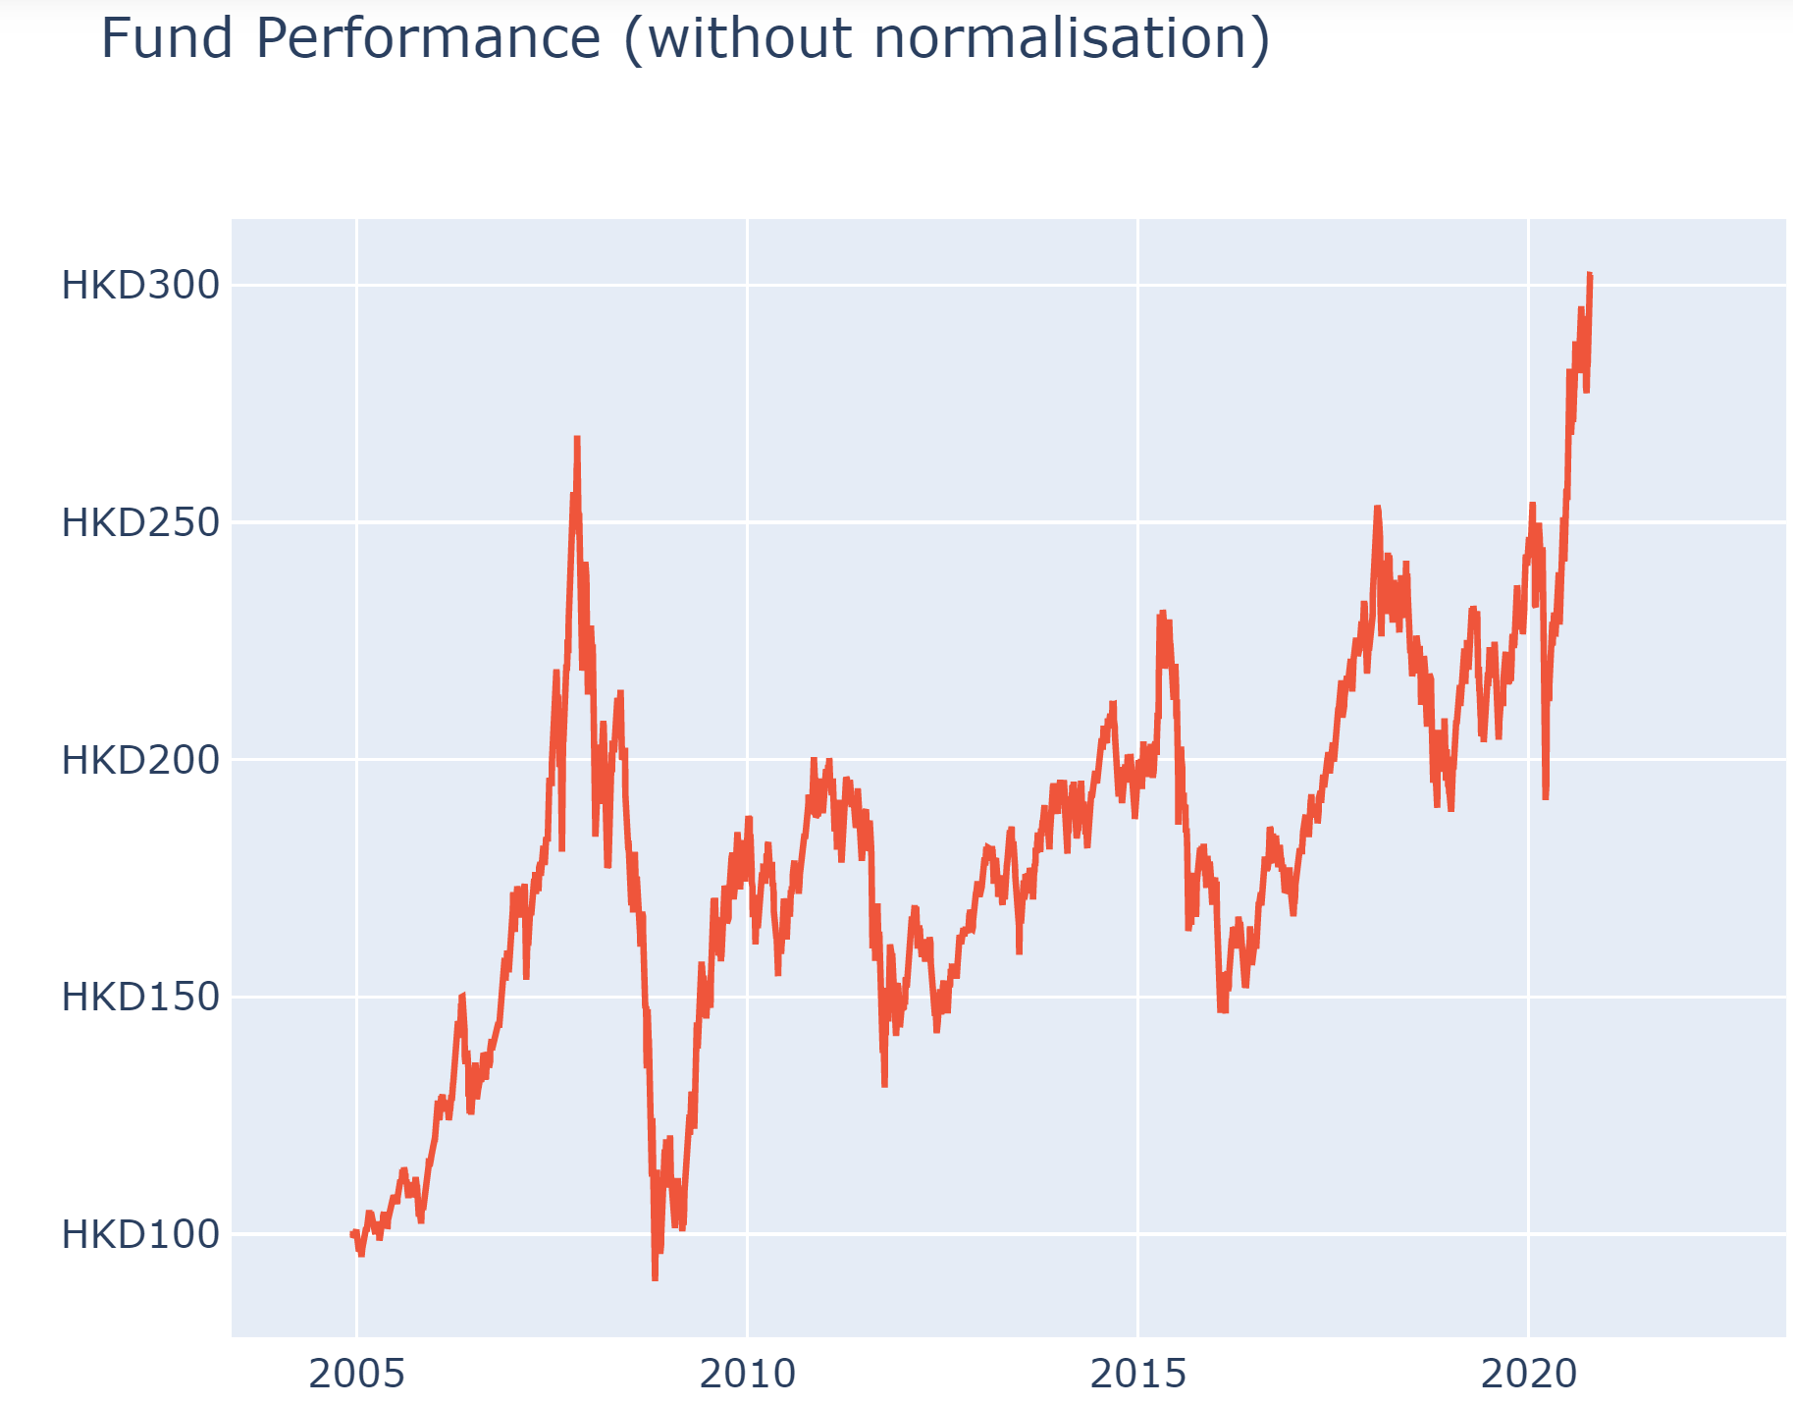
大中華股票基金

Slide 32
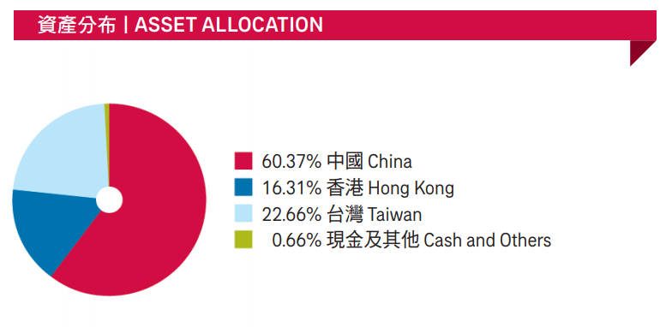
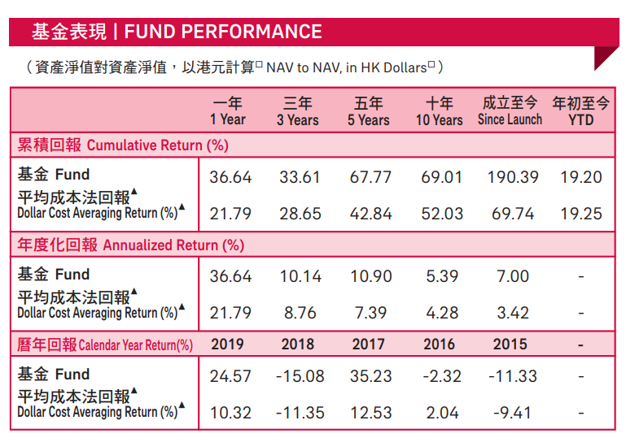
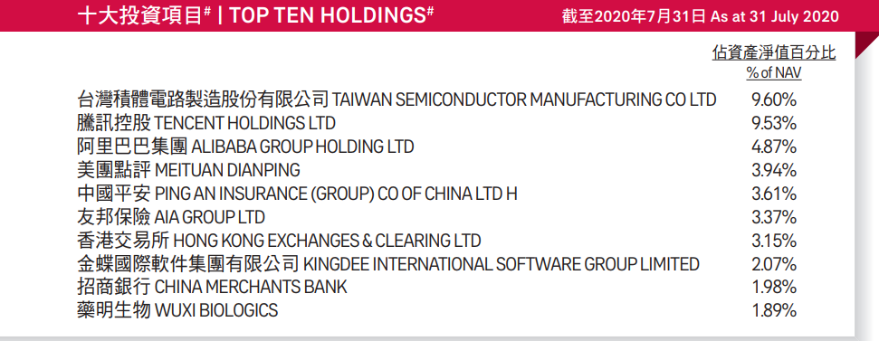
大中華股票基金
source:
aia mpf prime value choice fund performance review-aug-2020

Slide 33
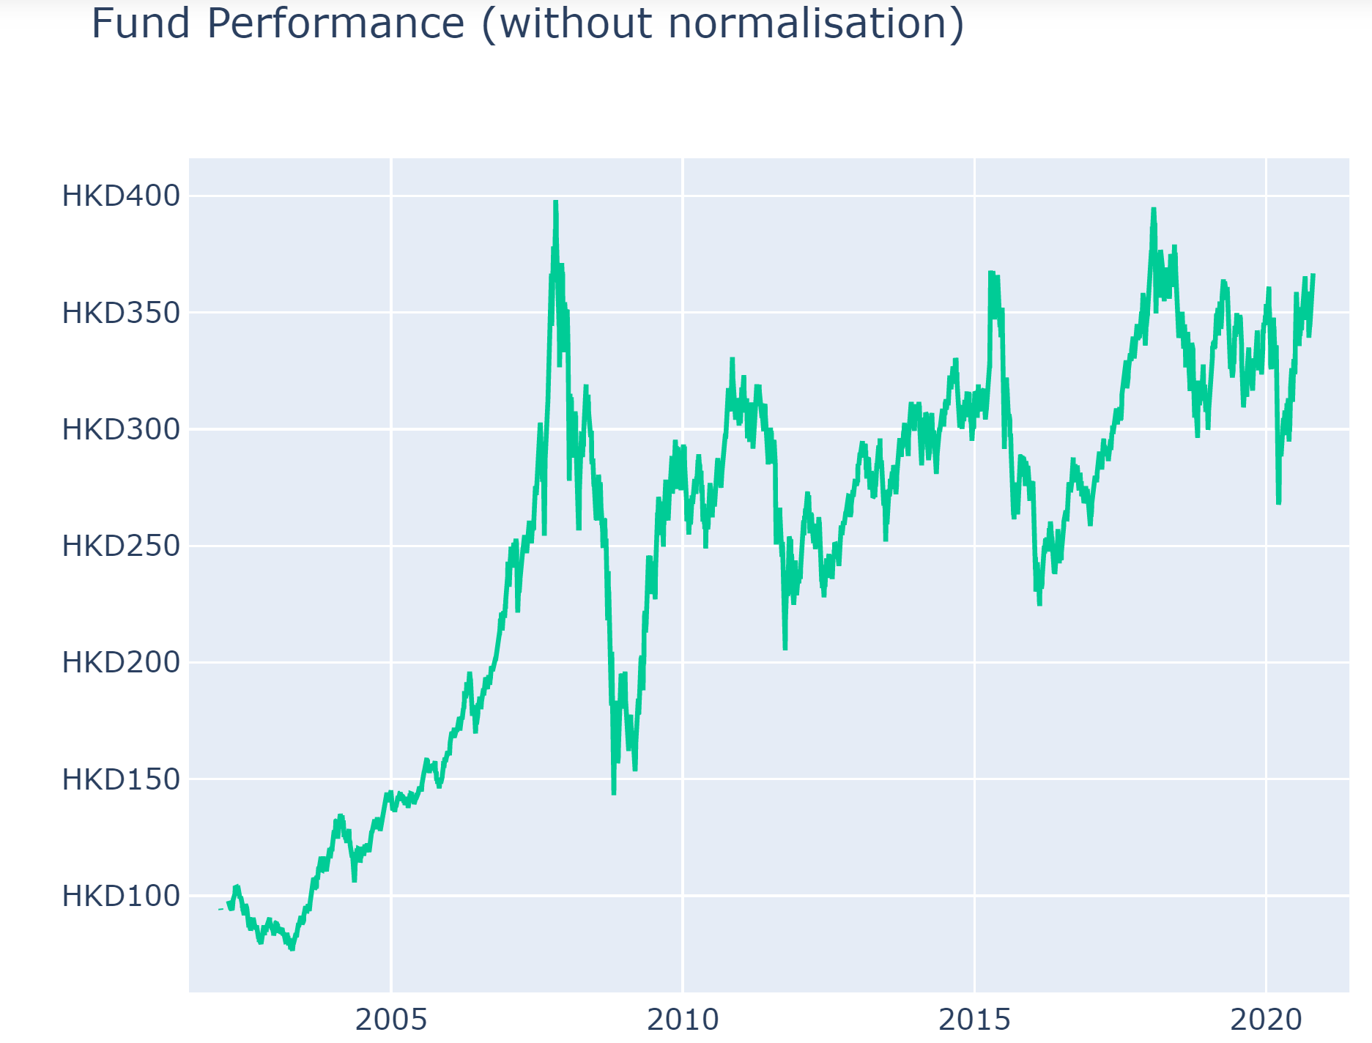
香港股票基金

Slide 34
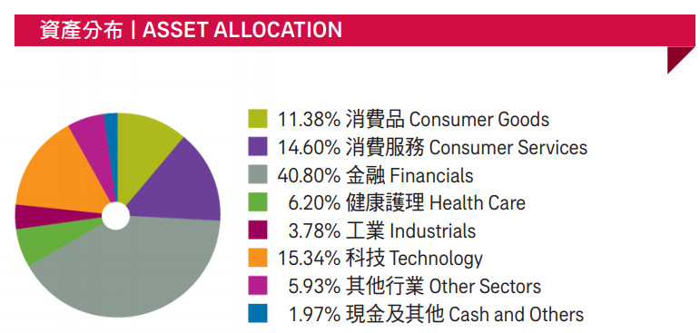
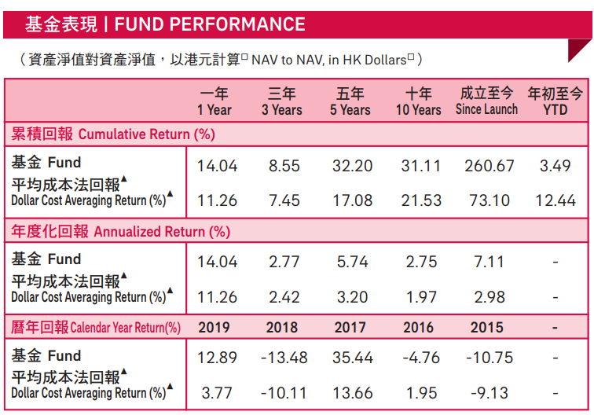
香港股票基金
source:
aia mpf prime value choice fund performance review-aug-2020

Slide 35
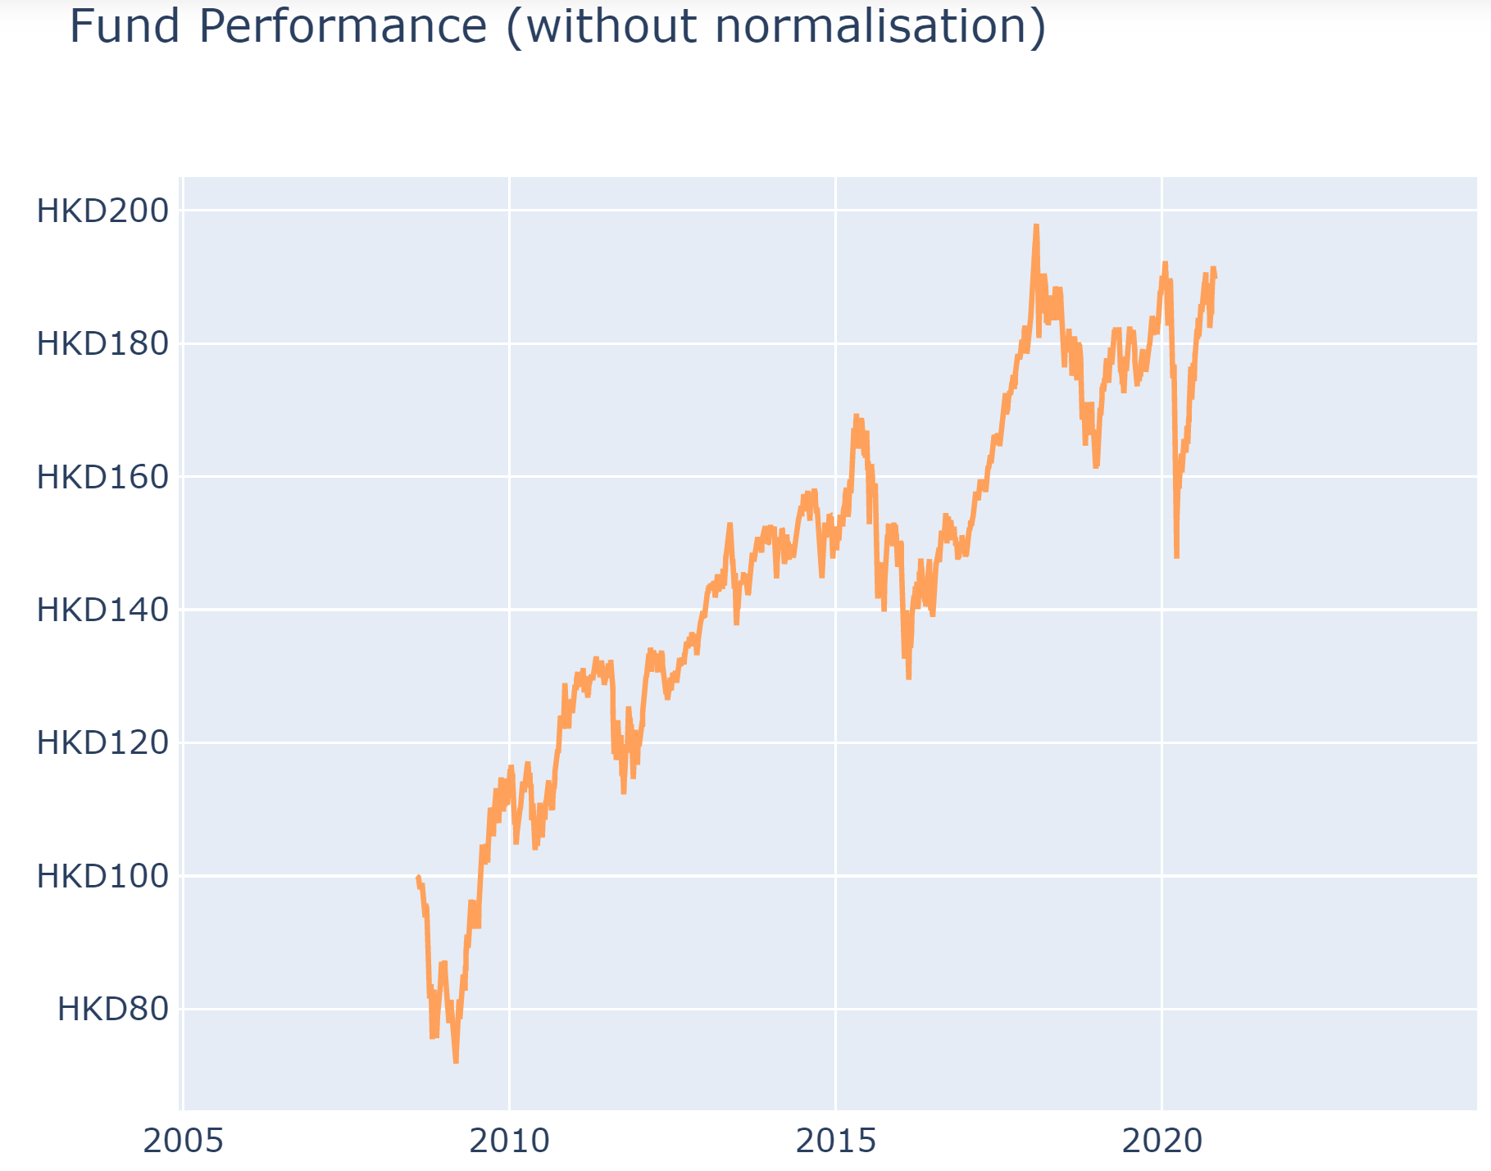
基金經理精選退休基金

Slide 36
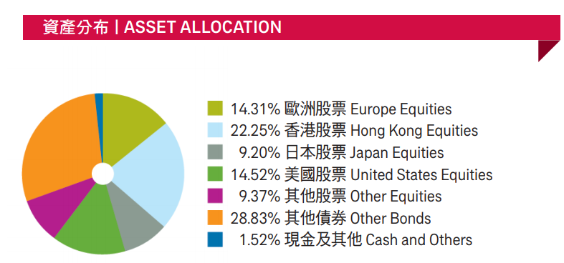
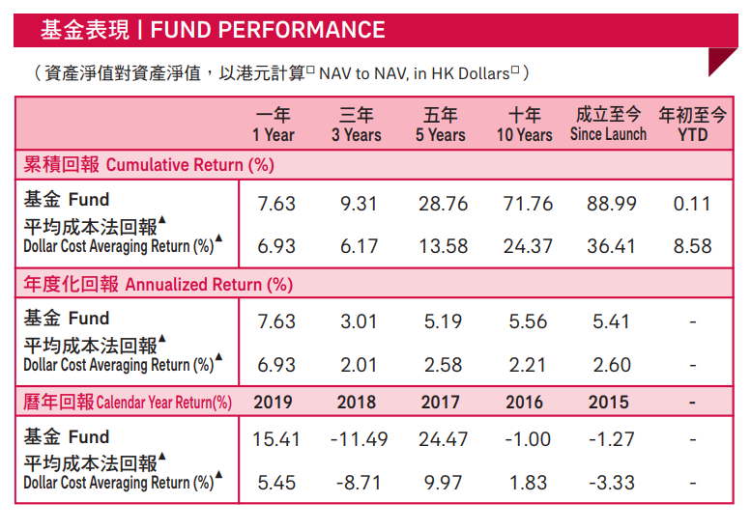
基金經理精選退休基金
source:
aia mpf prime value choice fund performance review-aug-2020

Slide 37
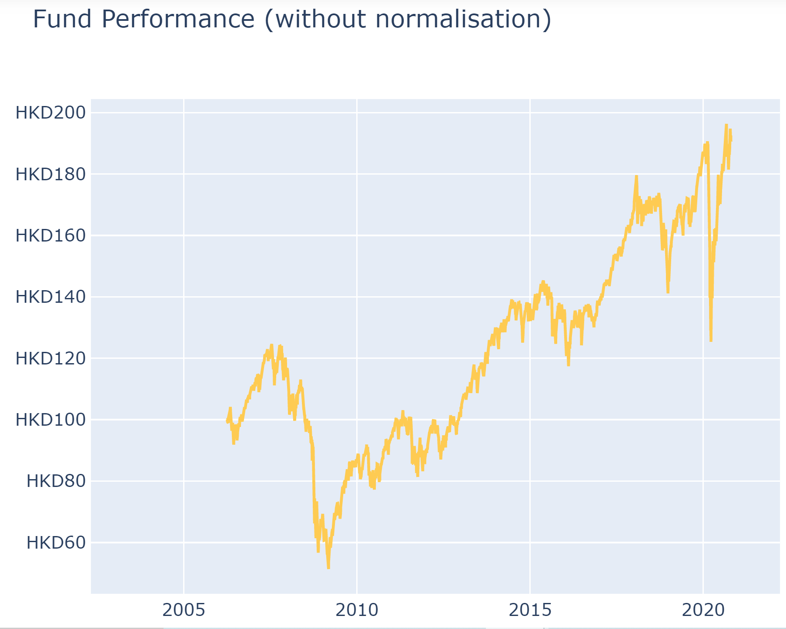
綠色退休基金

Slide 38
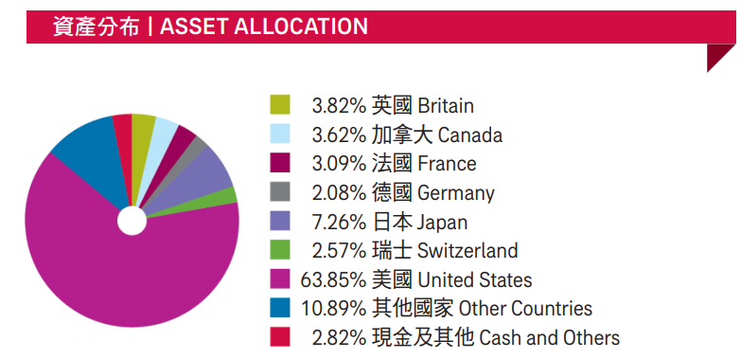
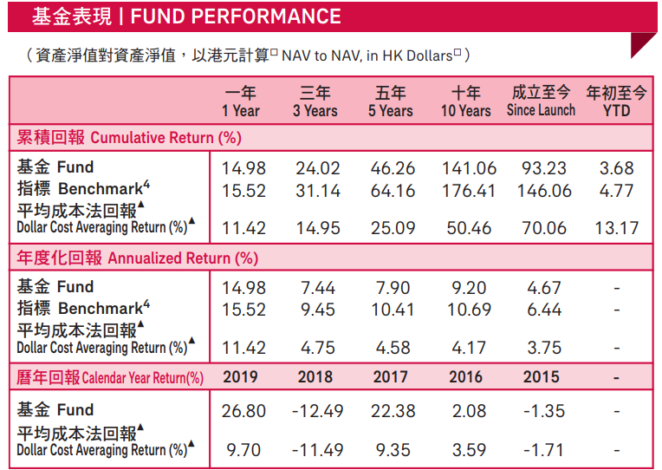
綠色退休基金
source:
aia mpf prime value choice fund performance review-aug-2020

Slide 42
oo
1. Content
Content
.
.
.
.
.
.
.
.
.
.
.
.

Slide 47
Content
Content
Content

Slide 49


Slide 50
Content
Content
Content
Content

